Slide 1
Courier Management
System
Simply ation related to delivery of the Courier

Slide 2

WELCOME
Me Awon, I am studying Computer Science at GC University Lahore. I am passionate about new technologies and tries to solve various problems.
Courier management system is fast and responsive. This system has full record of pervious couriers with detail. Moreover, this system is digital response system.
- AWON ABBAS
0075-BSCS-2019 “C”
awonabbas2@gmail.com

Slide 3

Problem
Create a Courier Management System in Java Project is to provide appropriate technology to help manager manage information.
The main aim of this project is to computerize the maintenance of courier management.
The main purpose of this system is to connect all branches to center database so the everywhere information is same. This system increases the efficiency and increases the customer satisfaction level.

Slide 4
Solutions
SENDER
RECEIVER
COURIER INFORMATION
Information of sender such that: Name, CNIC, Address, Phone Number
Receiver information such that: Name, CNIC, Address, Phone Number
Type of courier, Weight of courier, ID of the courier, Security level
SENDER DEPARTMENT
RECEIVER DEPARTMENT
JAVA LANGUAGE
Transporter Name, ID, Phone Number, Address, Courier documents
Collector Name, ID, Phone Number, Address, Courier Documents
Courier Management system project is implemented in Java Platform. We use java because it is one of the mostly used software all over the world
DELIVERY INFORMATION
Take the address of receiver delivery person take the confirmation from the receiver. Then he give the parcel to the receiver

Slide 5
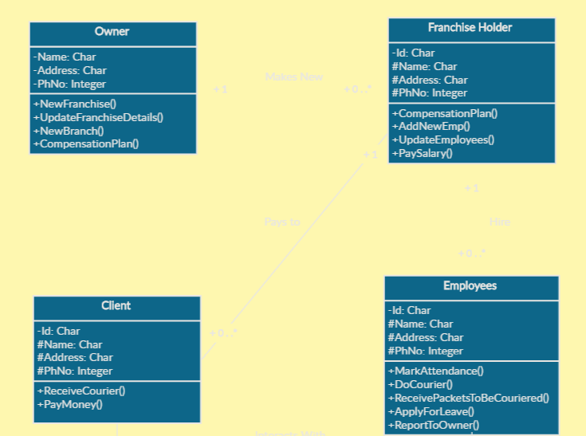
Proposed Class Diagram

Slide 6
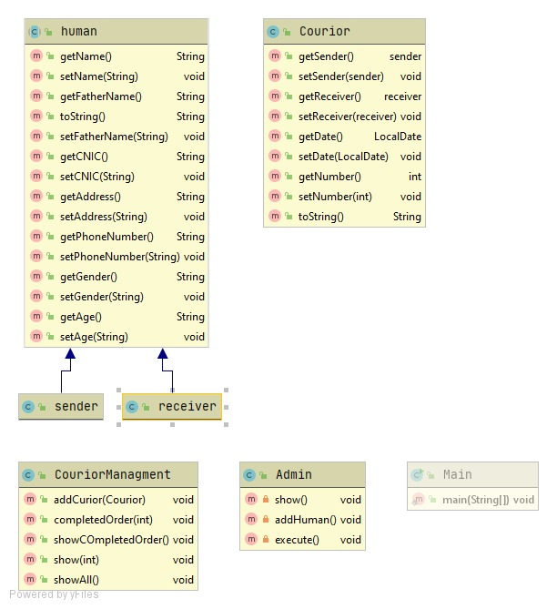
Class Diagram of submitted project

Slide 7

Screenshot of solution
When the program start its repuire user name and password. when the user name and password enter the program start futher.

Slide 8
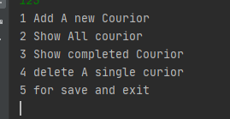
Screenshot of solution
•By running the program, this console based menu will appear in screen.
•It is demanding to get some input from the user
•After getting input this program will proceed further

Slide 9
We can use futher program according to our desire we can select any menu related to our need.

Slide 10
THANK YOU
Project name: Courier Management System
Name: AWON ABBAS
Roll number: 0075-BSCS-2019
Email: awonabbas2@gmail.com
Section : C

